Slide 1
Geoboard App Review
Kathryn Eary
Mathematics Group
Notes:
Hi everyone, my name is Kathryn Eary, and I am a member of the mathematics group. The app I chose to review for this final project is called Geoboard. This app is an explorational-based learning tool that can be used by students to develop their critical thinking and problem-solving skills while learning math and geometry topics.
While searching for high quality STEM apps I noticed many of them required a monthly or yearly subscription. While most of those options were definitely high-quality STEM apps, I wanted to explore an option that was completely free for users, to offer a more accessible option for math learning computer or mobile device.

Slide 2
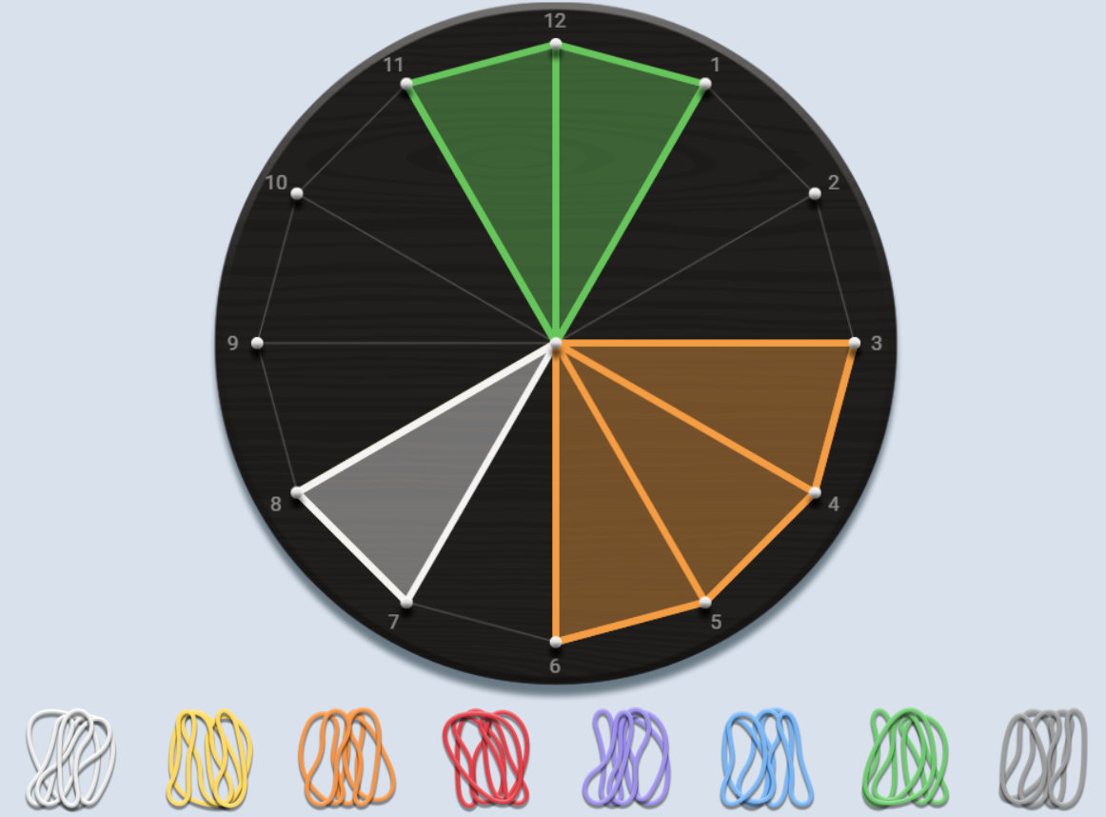
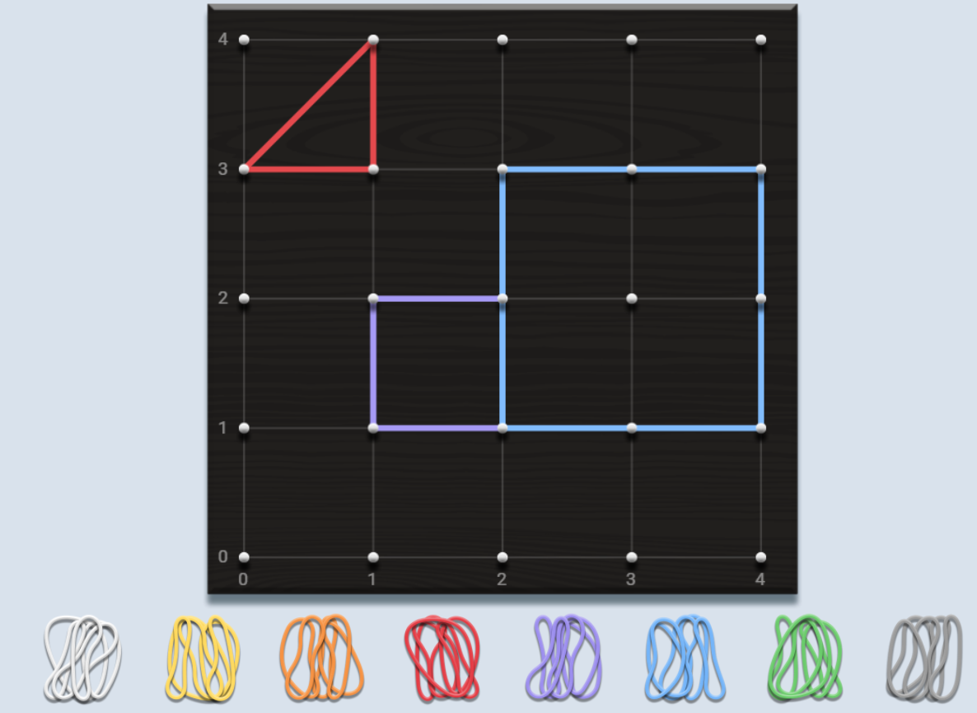
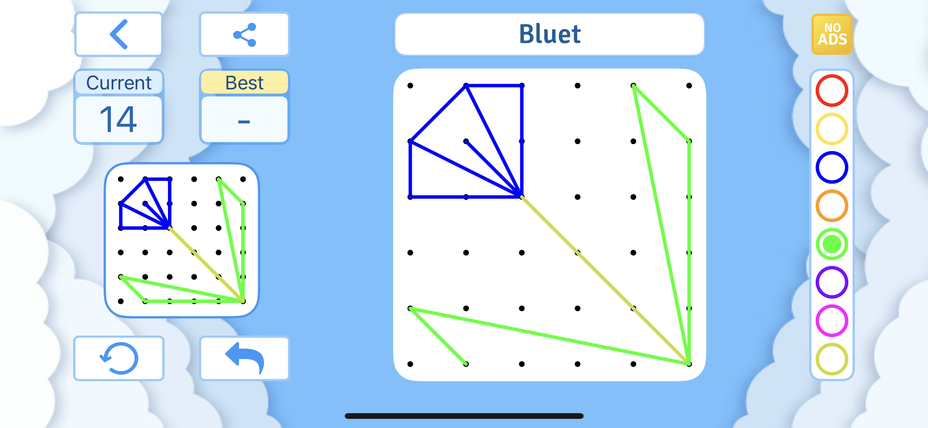
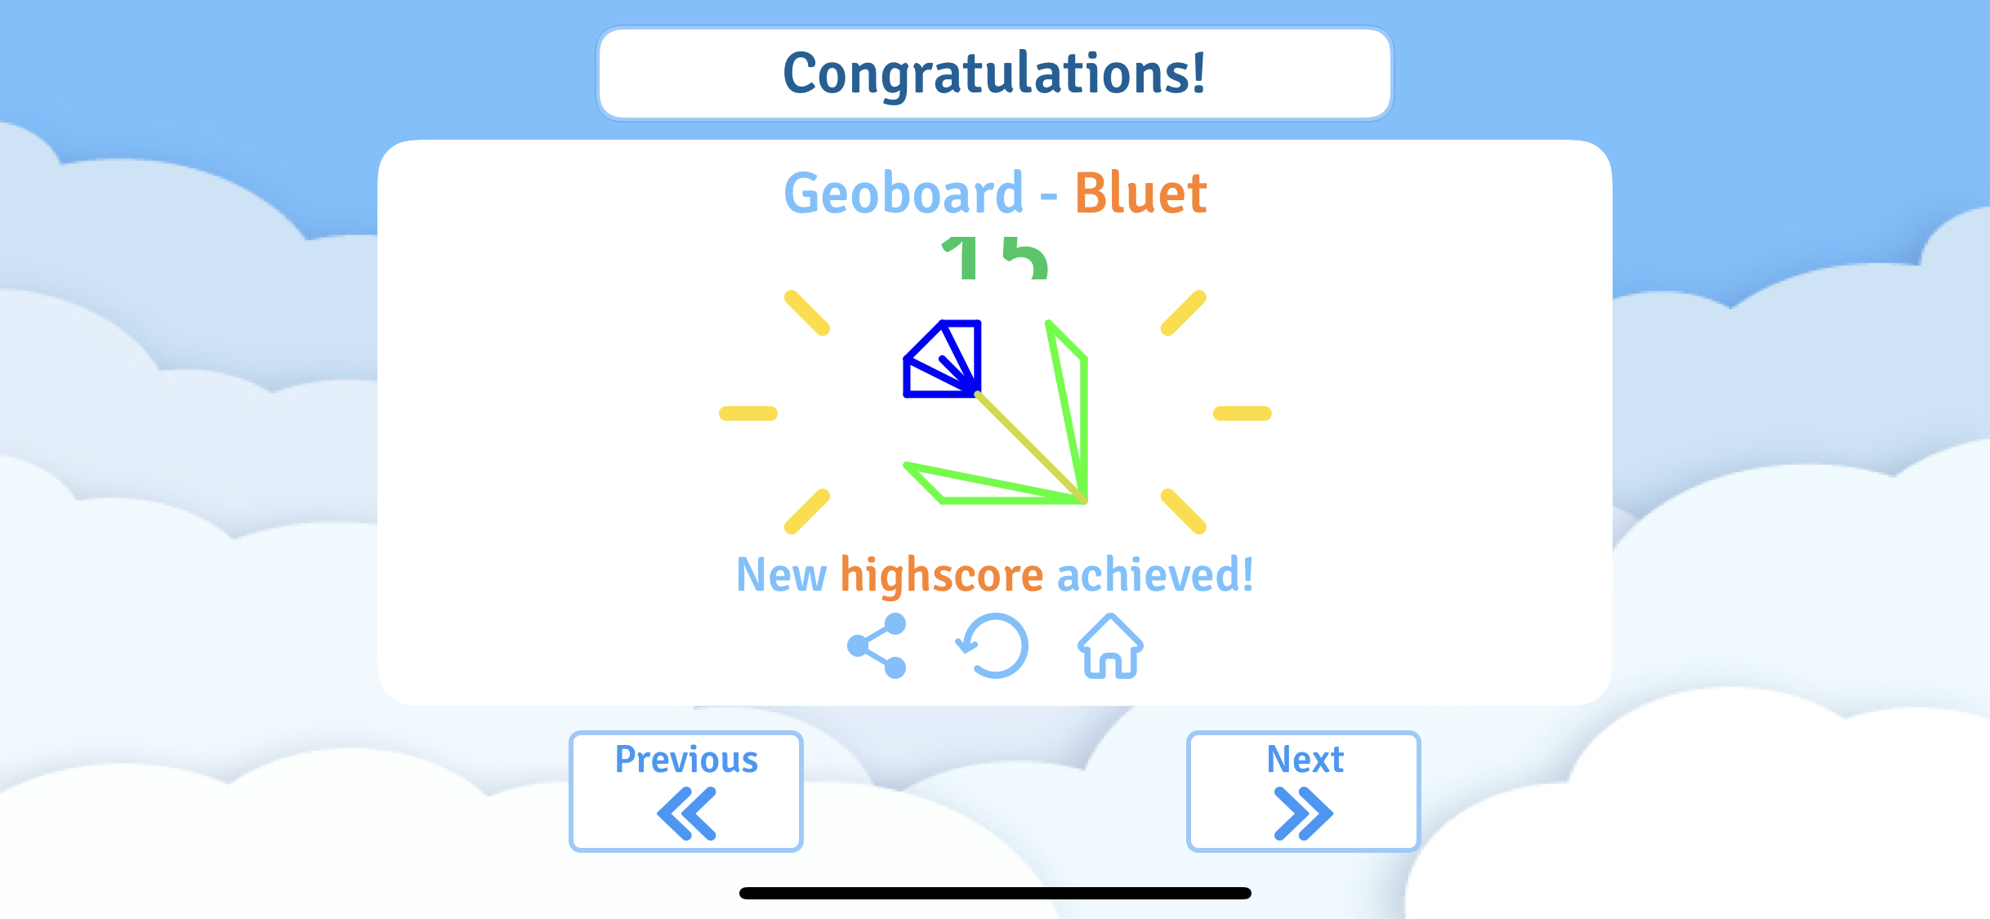
Geoboard
Free virtual manipulative
Google play, iOS, Android, Web App
Ages 4+
8 levels of difficulty based on grid size
Notes:
Geoboard is free virtual manipulative available on multiple platforms such as google play, iOS, Android, and it is also available as a web app. The top two pictures are from the web app and the bottom two pictures are from the iOS mobile app. There are slight differences in the layout between the two, but both offer useful tools to use when children are learning about various math and geometry concepts like perimeter, area, congruence, line segments, and more. The recommended user age range is ages 4 and up. The app offers 8 levels of difficulty based on the chosen grid size. The sizes range from a 3x3 board to a 10x10 board, and within each grid size are over 50 levels with an additional “creative mode”. Each level provides the child with an image on the peg board and the child is supposed to recreate the image exactly including the same colors. The app keeps track of a “high score” that is achieved by correctly completing the image in the least possible moves. The 3x3 grids include learning to draw numbers and letters, while the more intricate grids include more complex images with more colors.
The web app is also useful because it offers the use of grid lines, grid numbers, and fill in options. The web app would be a useful hands-on addition to a classroom setting when learning about certain geometry concepts.

Slide 3
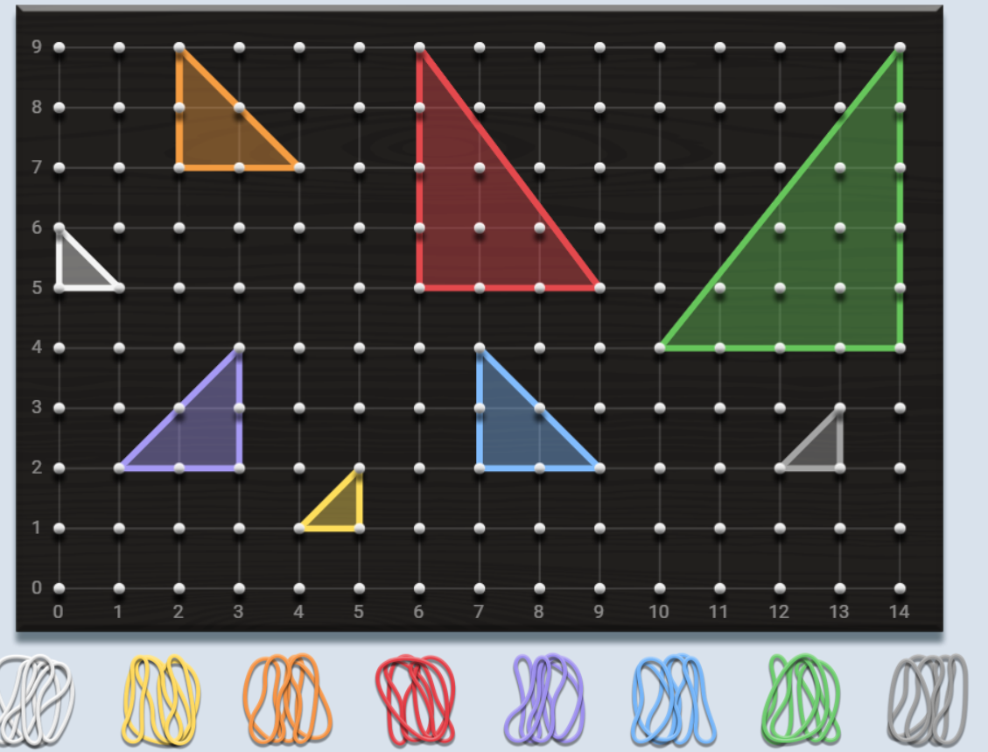
Family Activity
An adult can create a geoboard including various shapes and colors
Pose questions to children about matches in terms of shapes, sizes, colors, orientations, etc.
Could also ask child to recreate shapes with certain characteristics on their own
Notes:
An idea for a family activity that I had was for an adult to create a geoboard that includes various shapes, colors, and sizes. For example, I made this one with variously sized triangles of different colors and orientations. The adult could then ask the child to make connections between the shapes on the screen and pair them together based on color, then pair them based on area or size. For example, the adult could ask the child to find triangles that are the same size as the white triangle on the screen, or for older children they could ask them to calculate the areas for different shapes on the screen. Another activity could be for the adult to give the child a list of characteristics, and the child must then create an image/shape that meets all the criteria using the Geoboard app. This app gives adults an opportunity to provide interactive learning activities for their learner, and I think the web app could also be used as a great supplement for teachers to provide a visual and hands-on tools when learning about geometry topics.

